Slide 1
In the Beginning
It was fall 1983. I was starting the 8th grade when an acquaintance told me about games in the “Computer Lab”
??? What the heck is a computer!!! ???

Slide 2
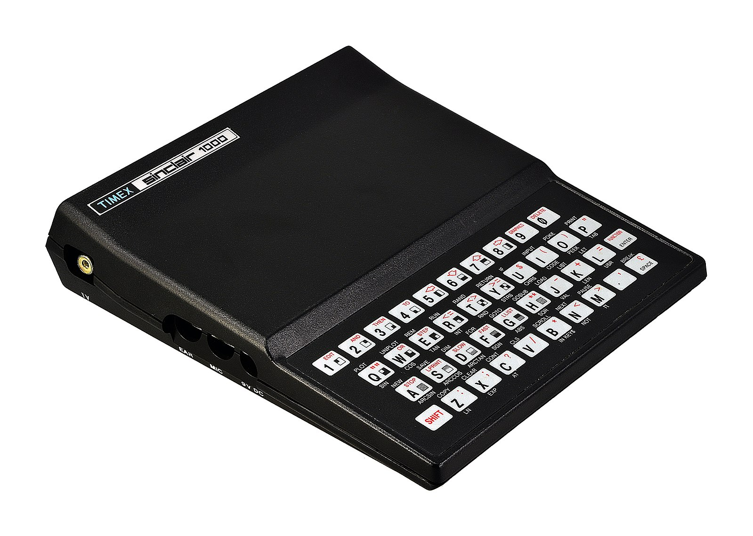
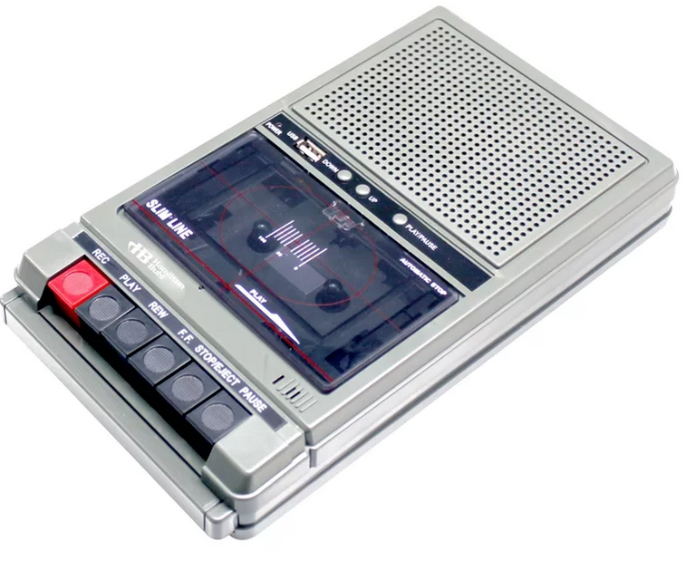
My First Computer
Timex Sinclair 1000
2Kb of RAM
Regular tape recorder for storing/loading programs
Notes:
* Spent a week trying to figure out how to print my name. Once I figured this out (syntax), the world opened up and I was officially a “NERD”

Slide 3
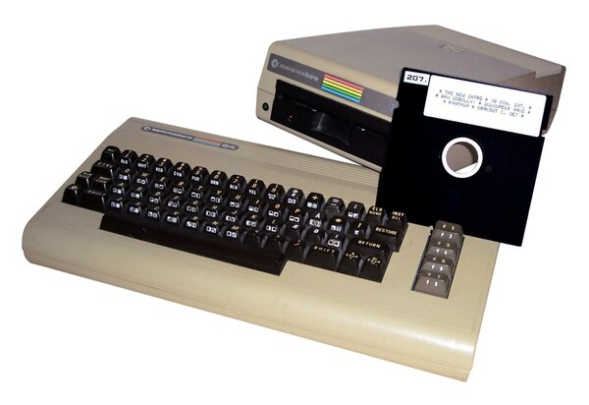
1984 - Year of the Commodore
Xmas 1984, I stepped up my game!
Summer Games
Winter Games
Basic Programming

Slide 4
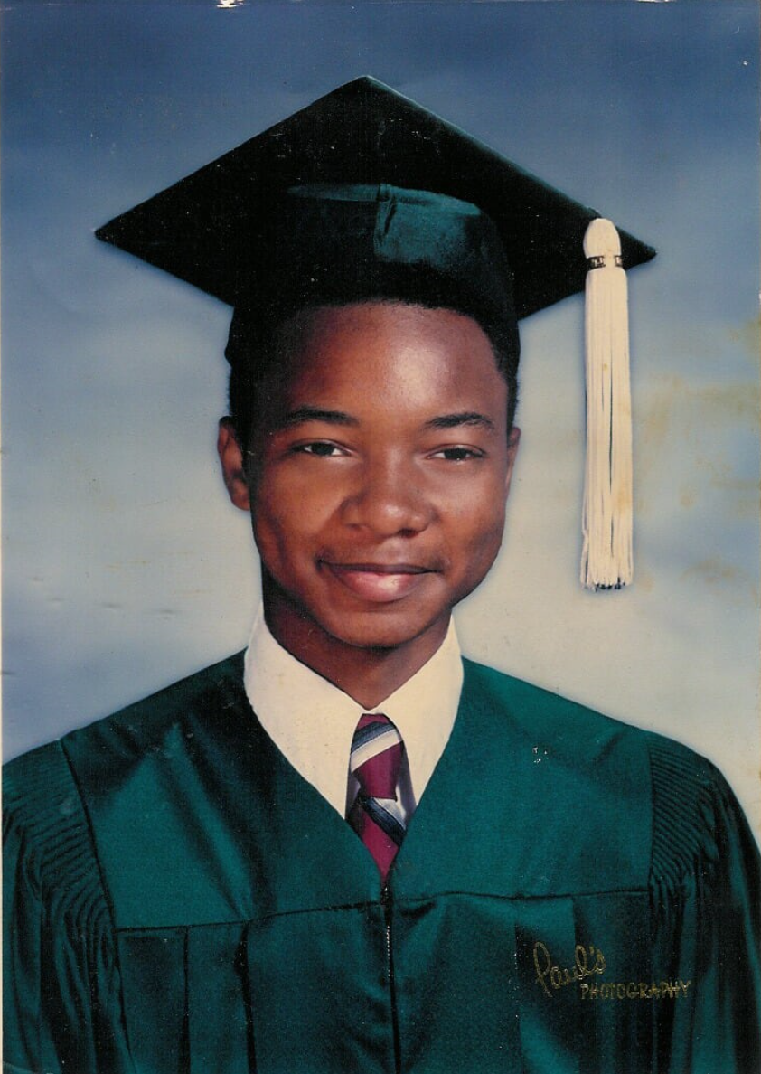
Summer of 1985 - 1988
BBS (Bulletin Board Systems)
Assembly Language
Blue Boxing (this is not confirmation, only something from that time)
Emerald Soft – Me and a friend registered a business and pushed software (Assembly Advantage – Disassembler & Font editor/generator).
What can I confirm that I did?
Developed games
Developed BBS

Slide 5
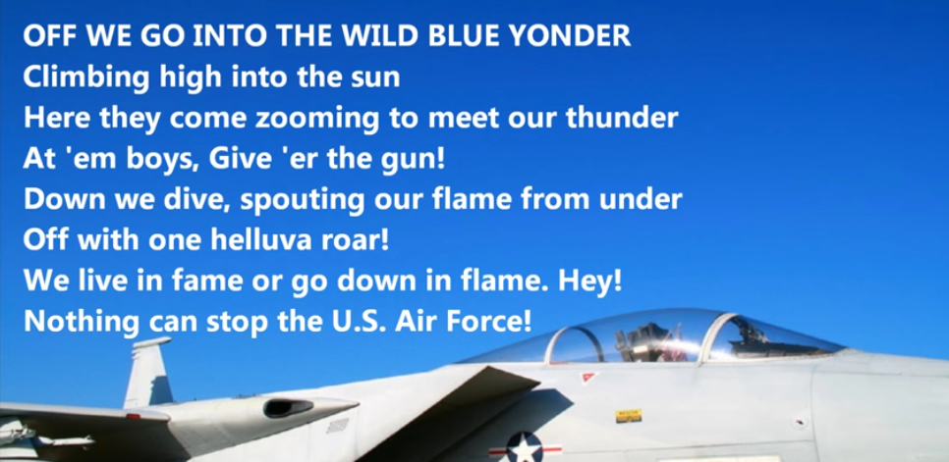
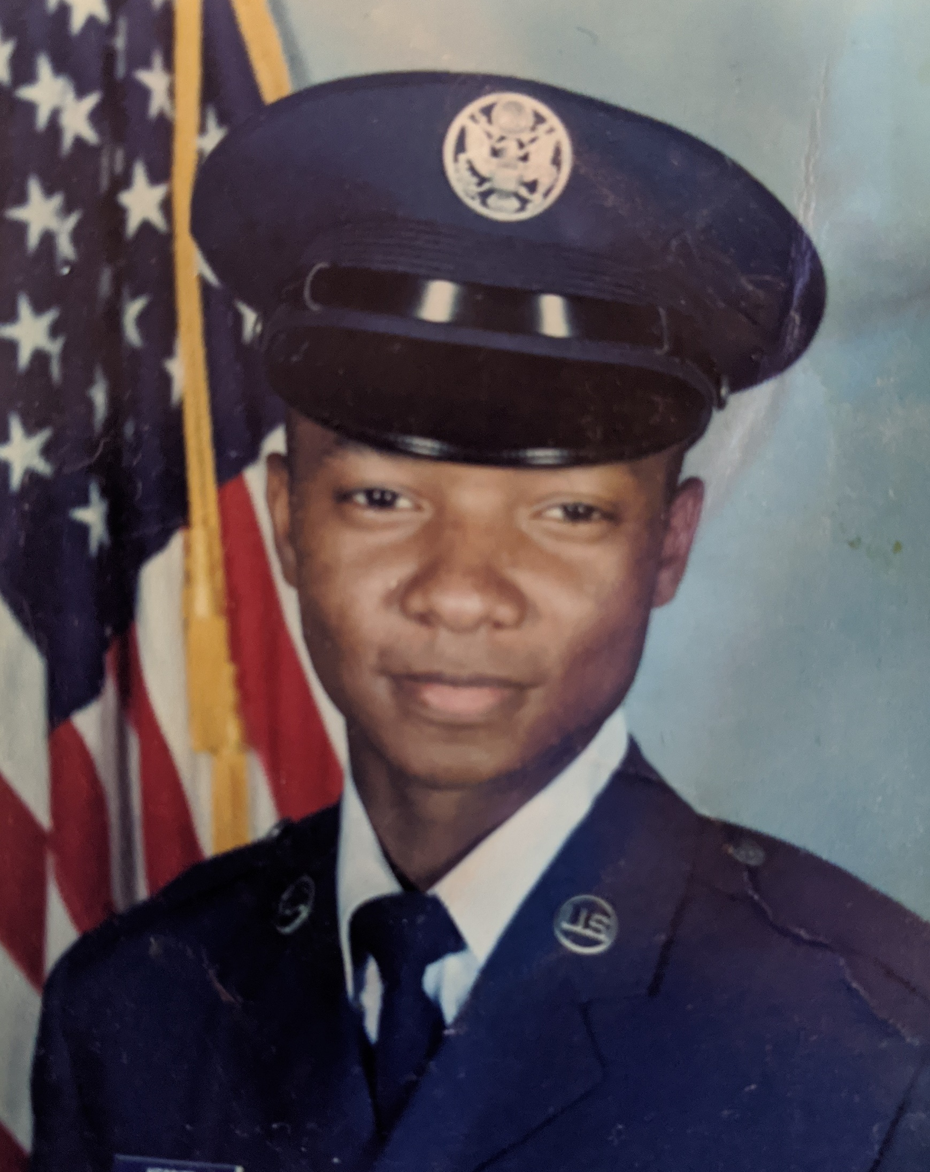
1988 – 1994 : US Air Force
Assignments
Holloman AFB, NM
Brunssum, The Netherlands

Slide 6
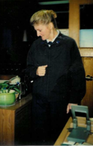
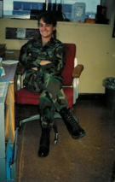
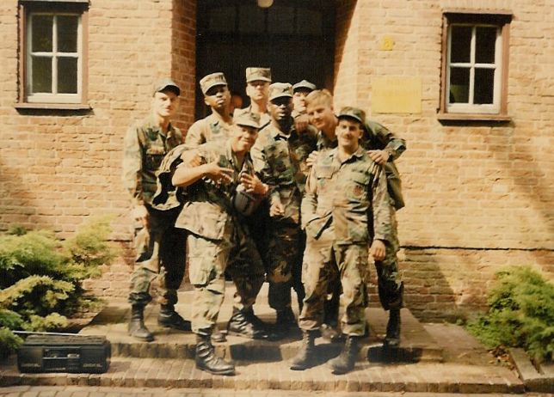
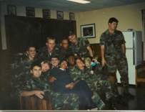
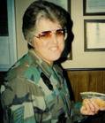
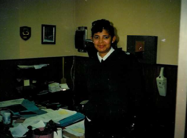
Holloman AFB – TAC (1988 – 1991)

Slide 7
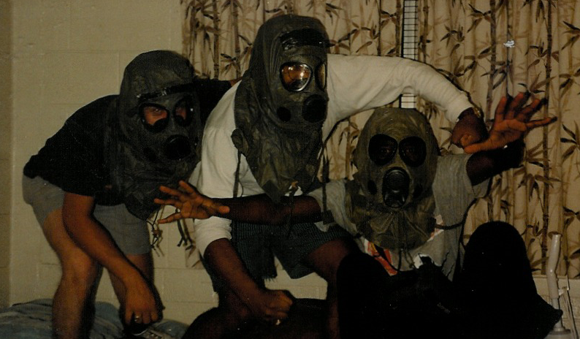
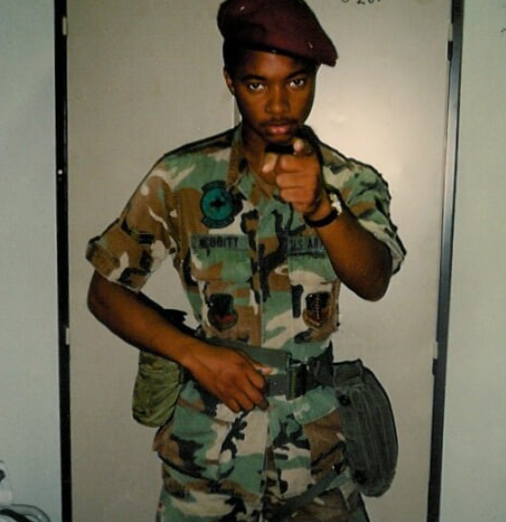
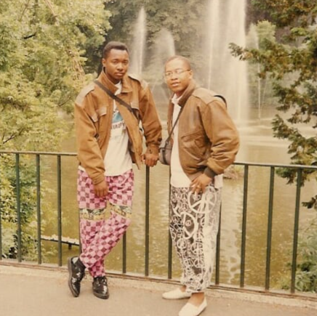
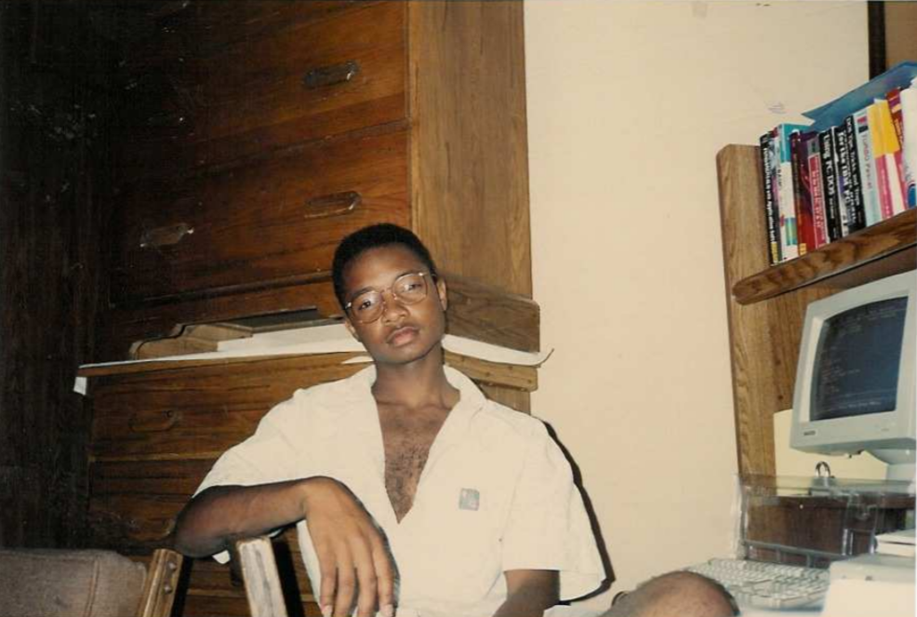
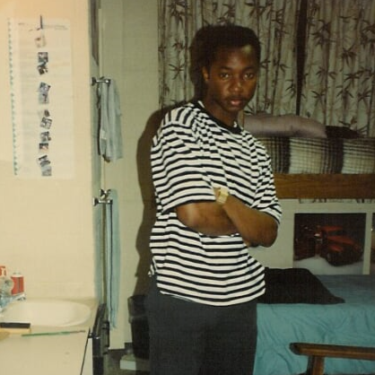
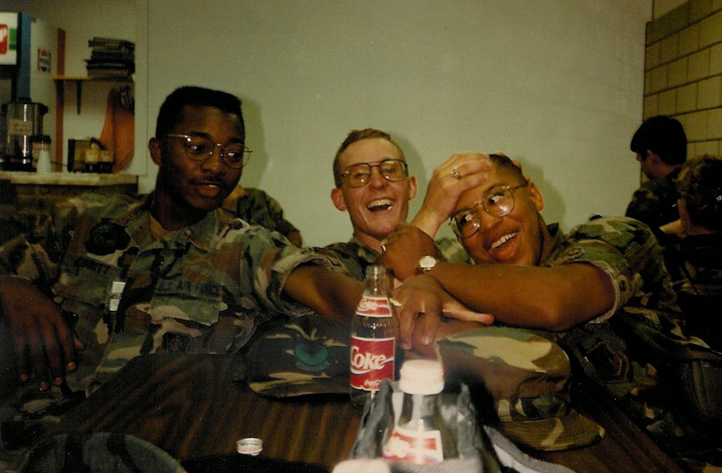
THE MAN, THE MEN, NOT!!!!

Slide 8
Brunssum - NATO – AFCENT (1991 – 1994)
The Netherlands
Germany
Belgium
France
Luxembourgh
Austria
Greece

Slide 9
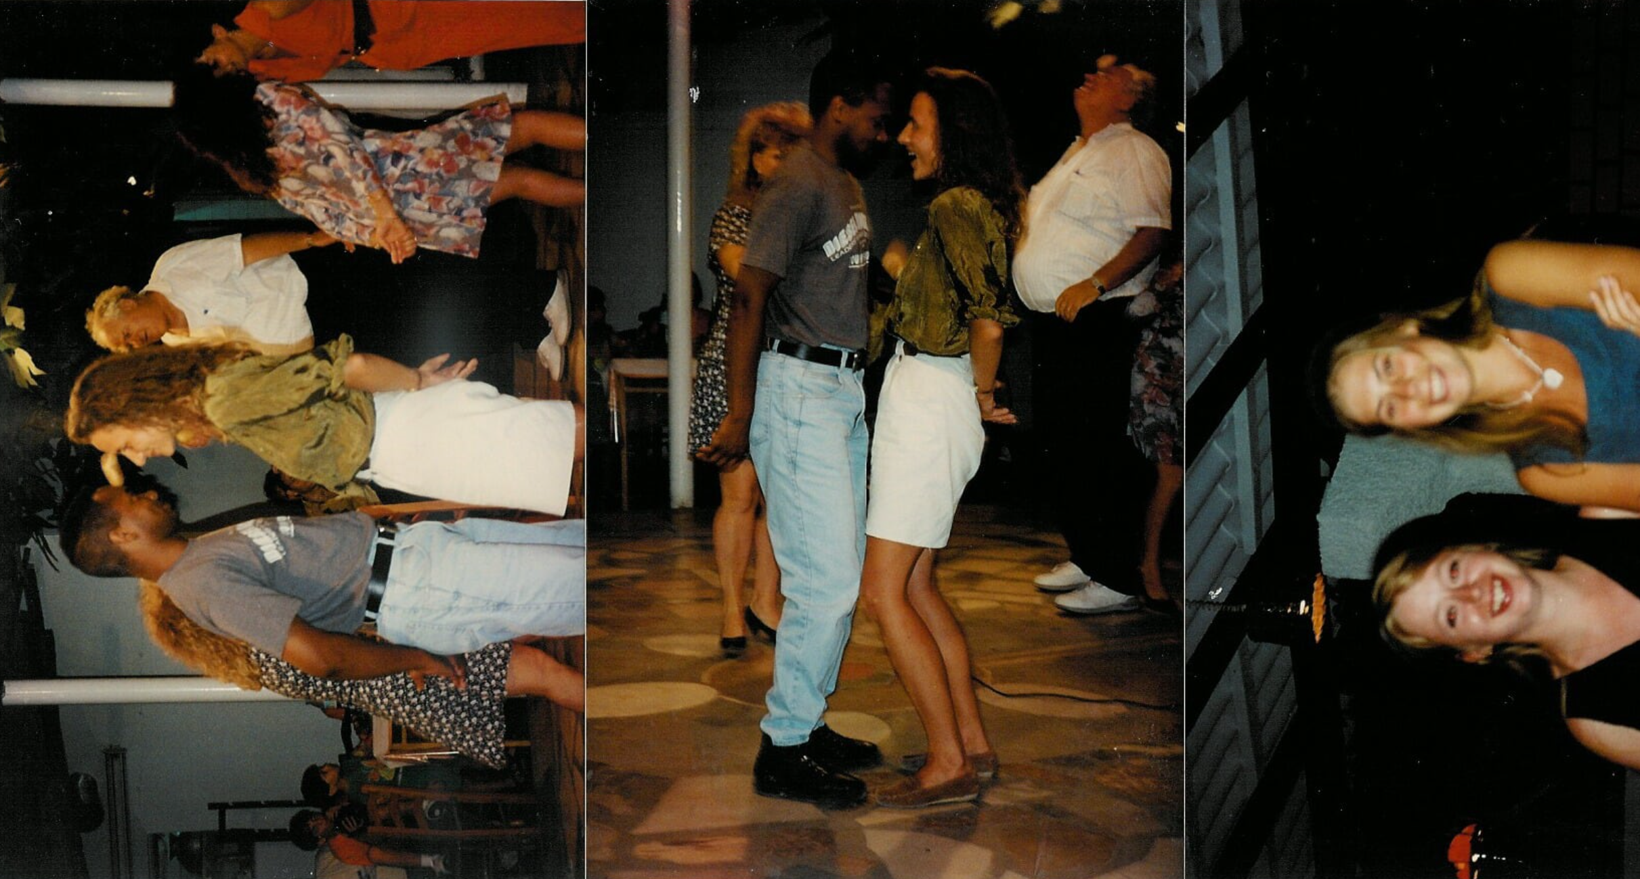

Slide 10
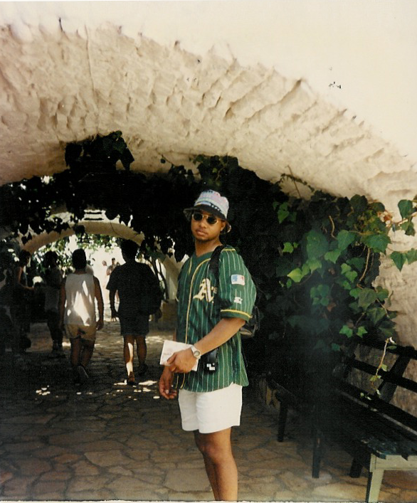
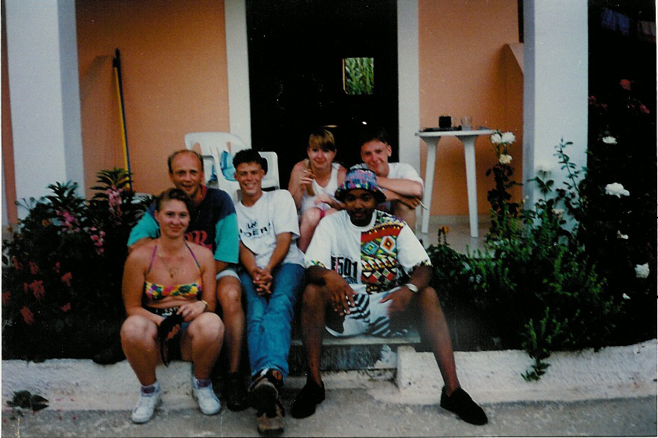
I do know how to look like a tourist…

Slide 11
1994 – Return to US : Dallas, TX
Separate from AF
Worked as truck driver & operation supv from 94 – 97
98 took first full-time tech job as IT Manager
2002 accepted at mortgage company in imaging team
2005 accepted at JPMC

Slide 12
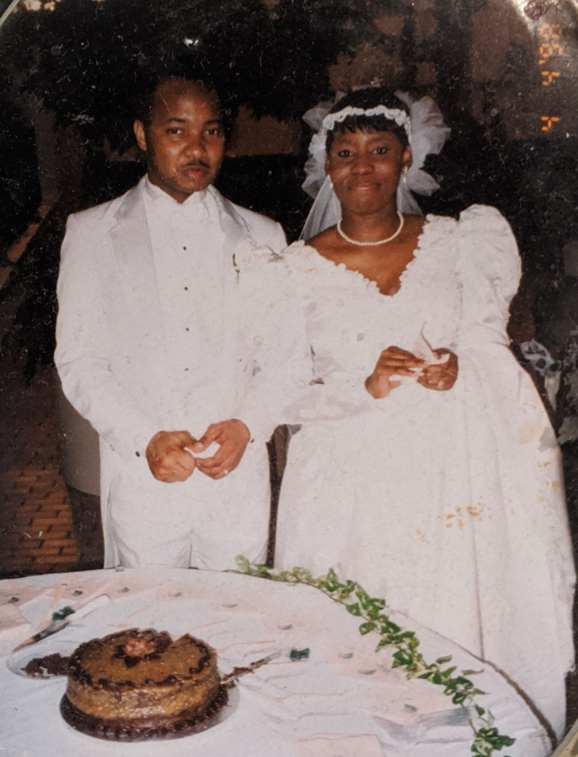
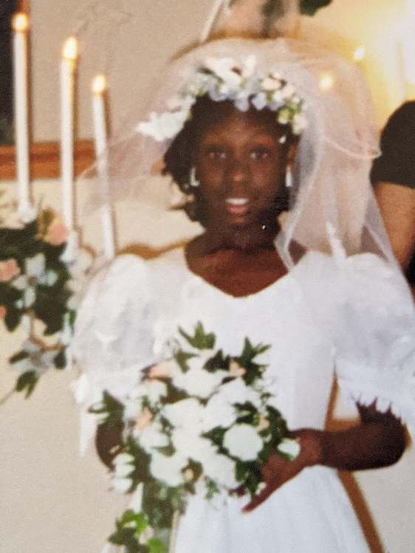
Significant events starting in 1998
Me, my wifey, and Kiki

Slide 13
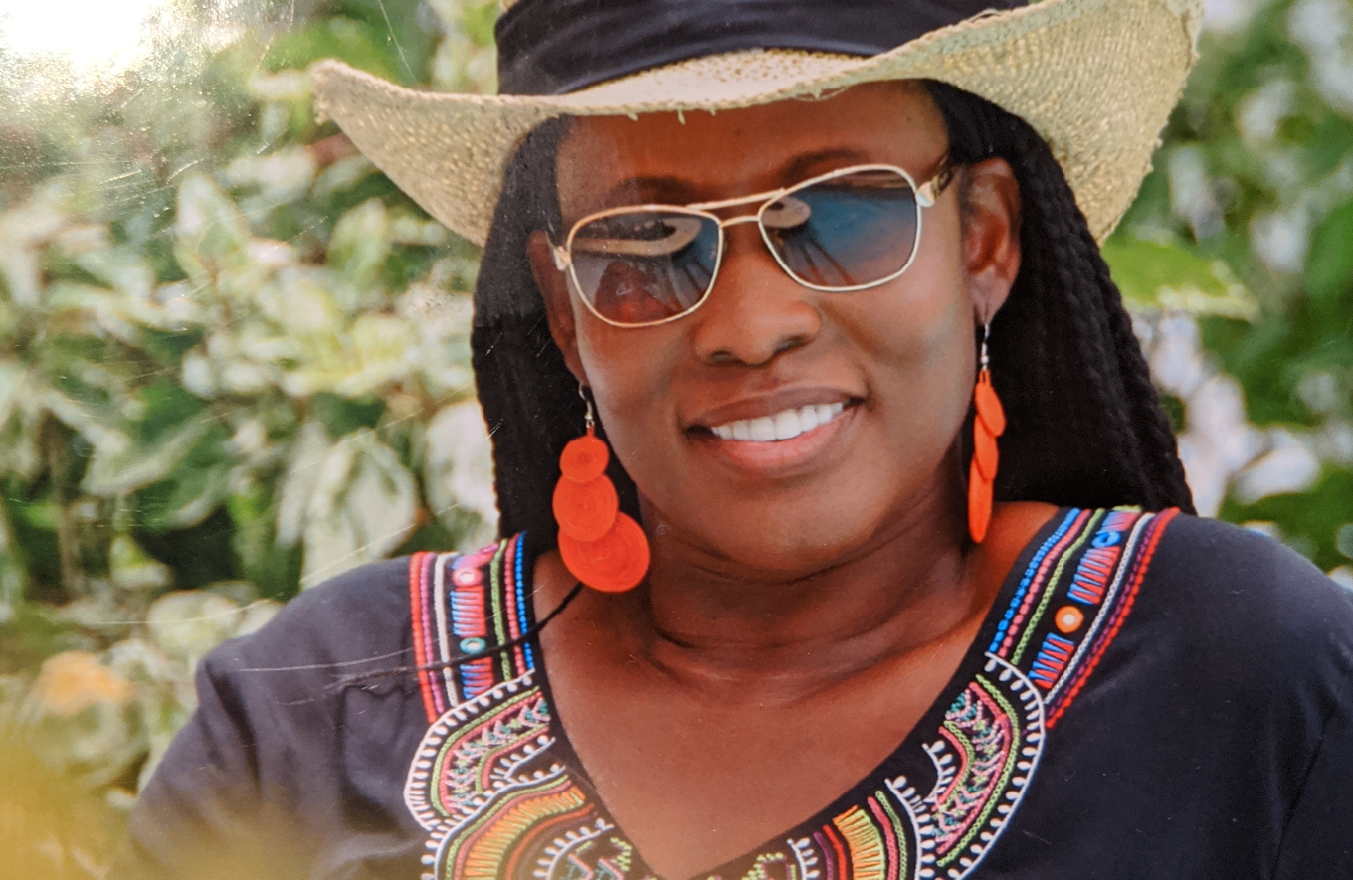
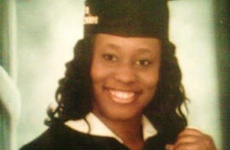
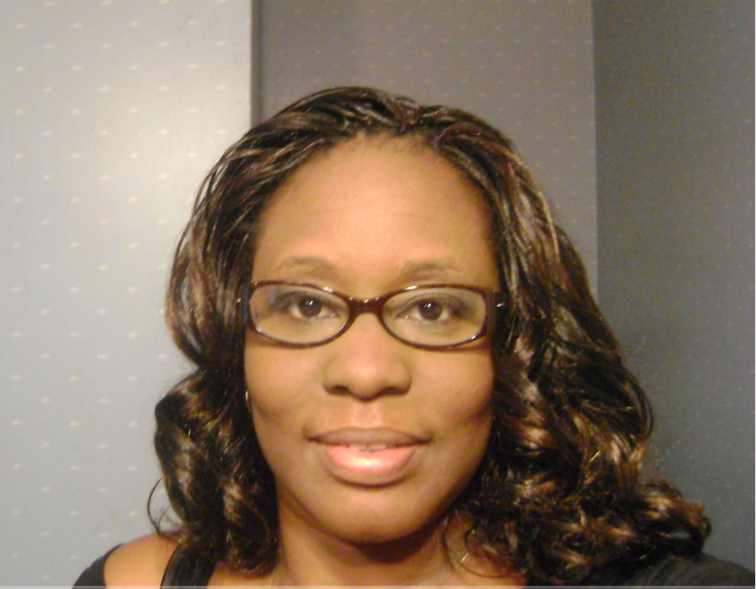
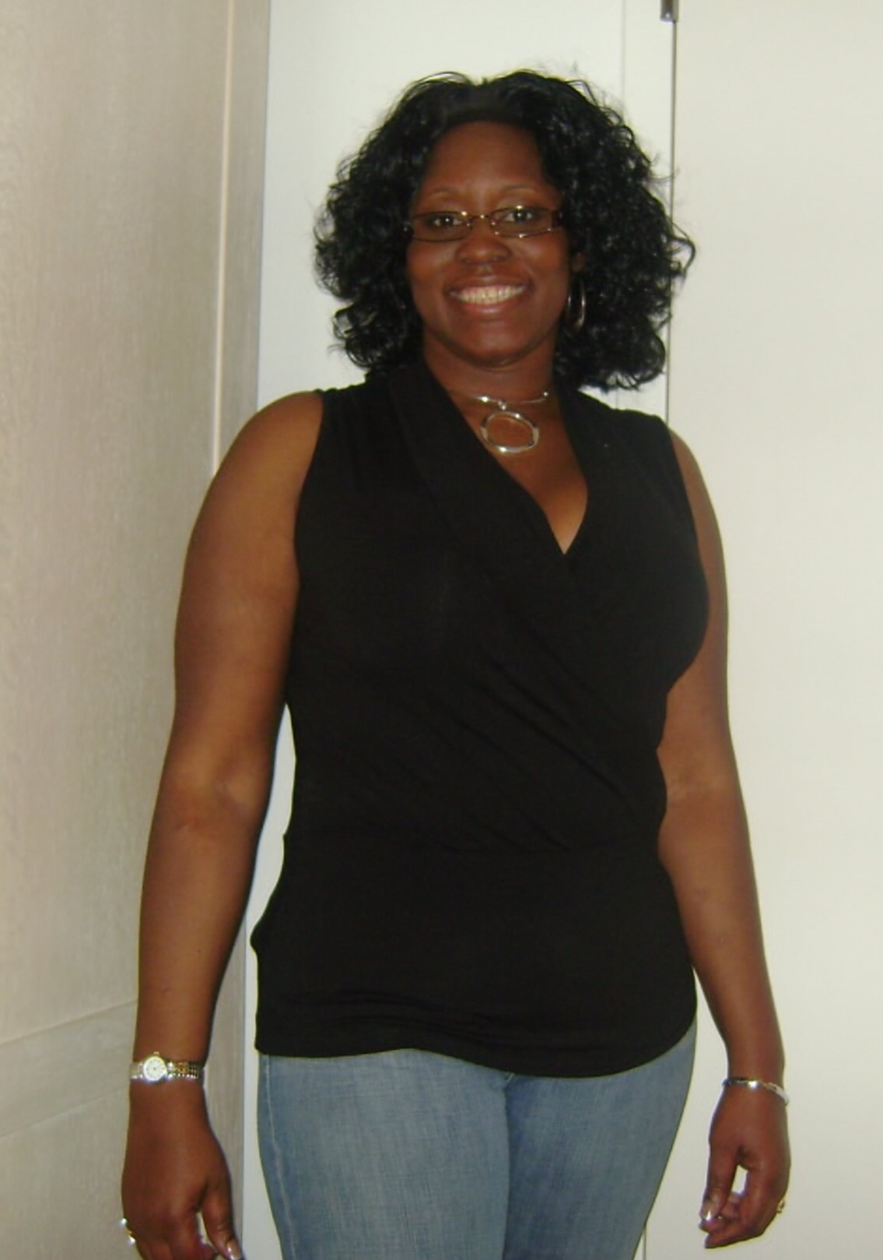
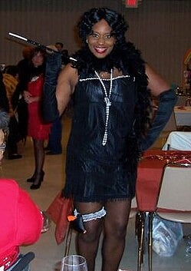

Slide 14
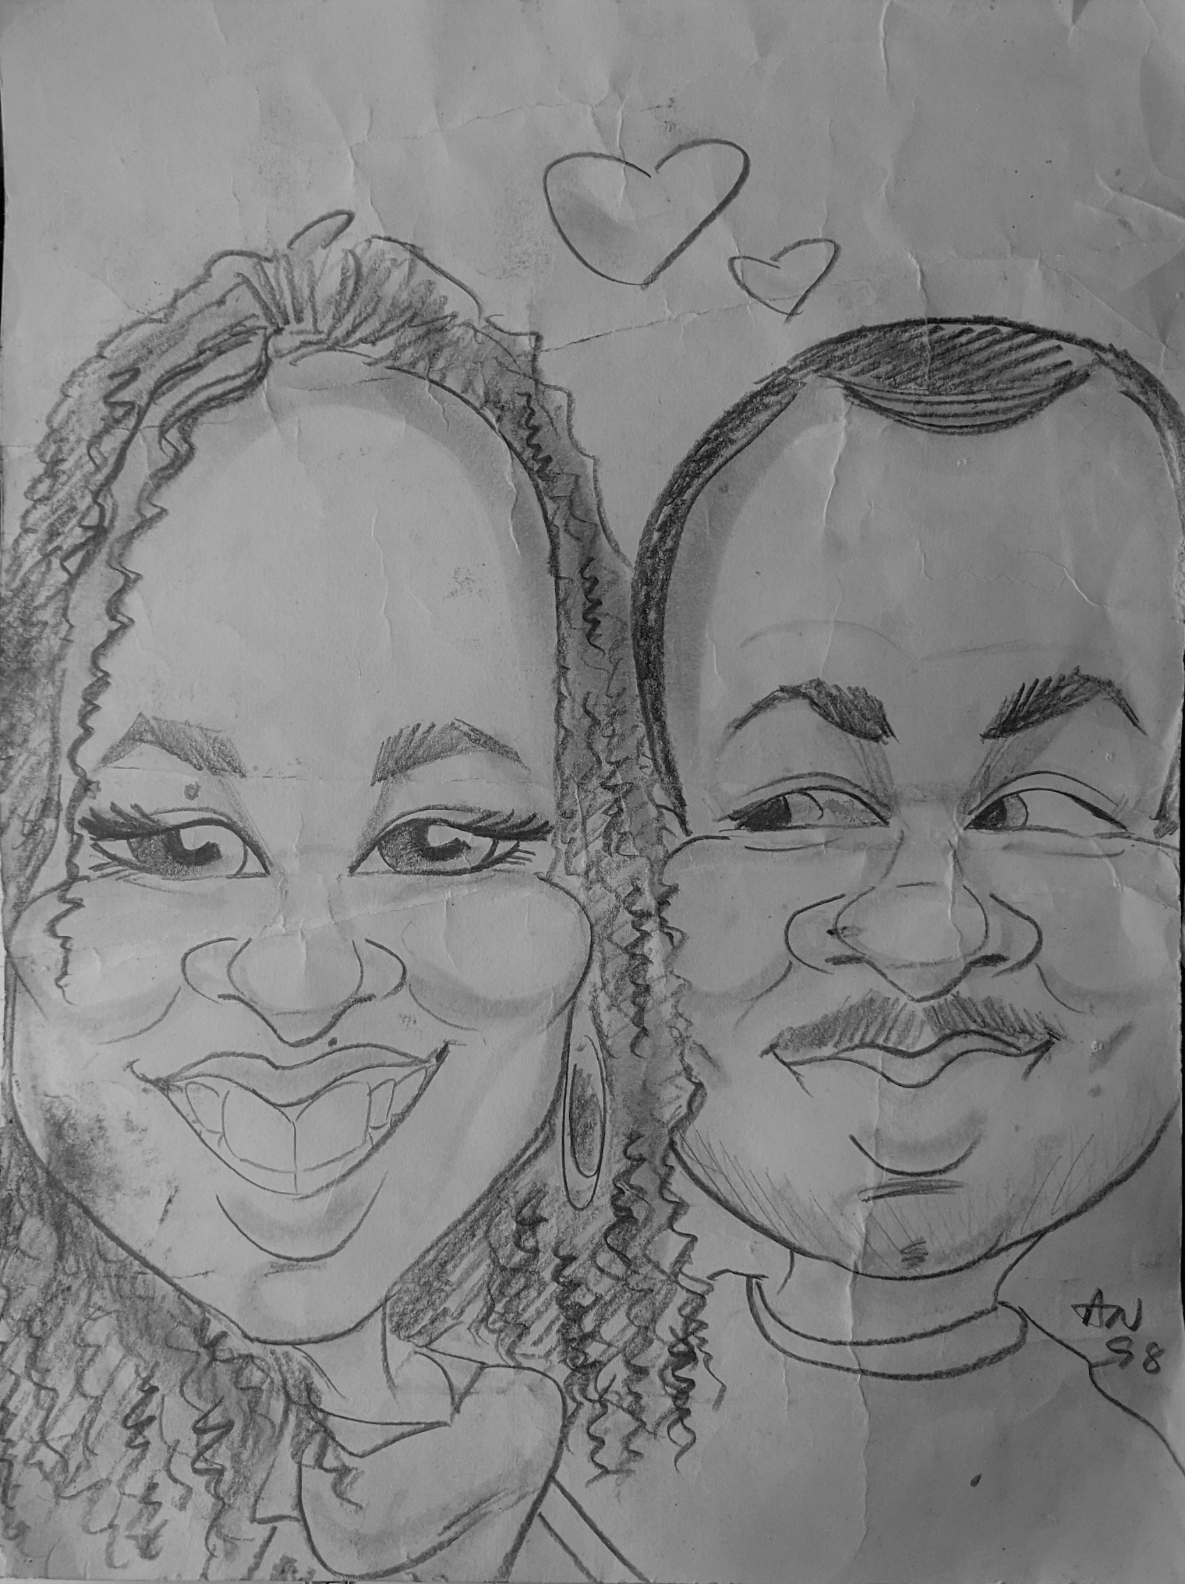
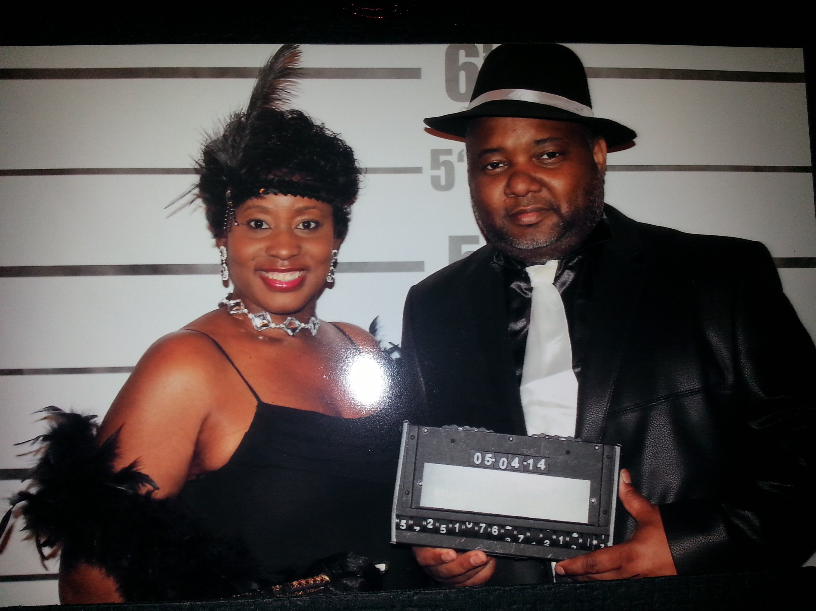
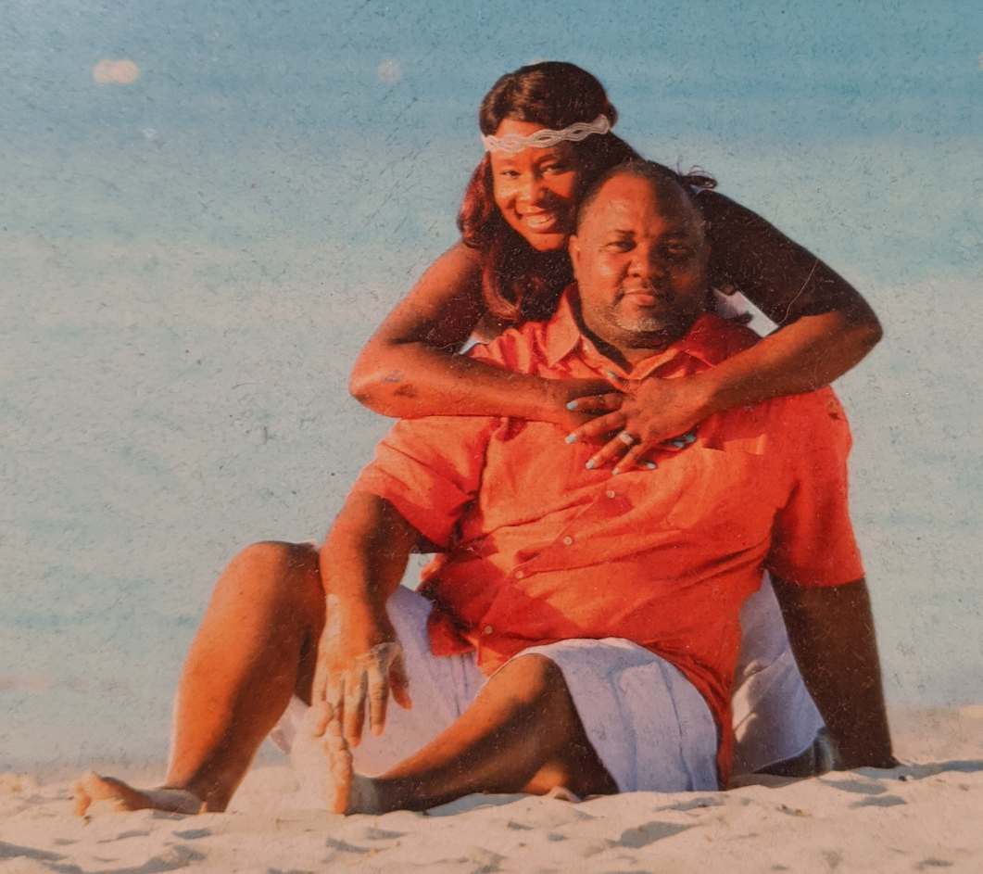
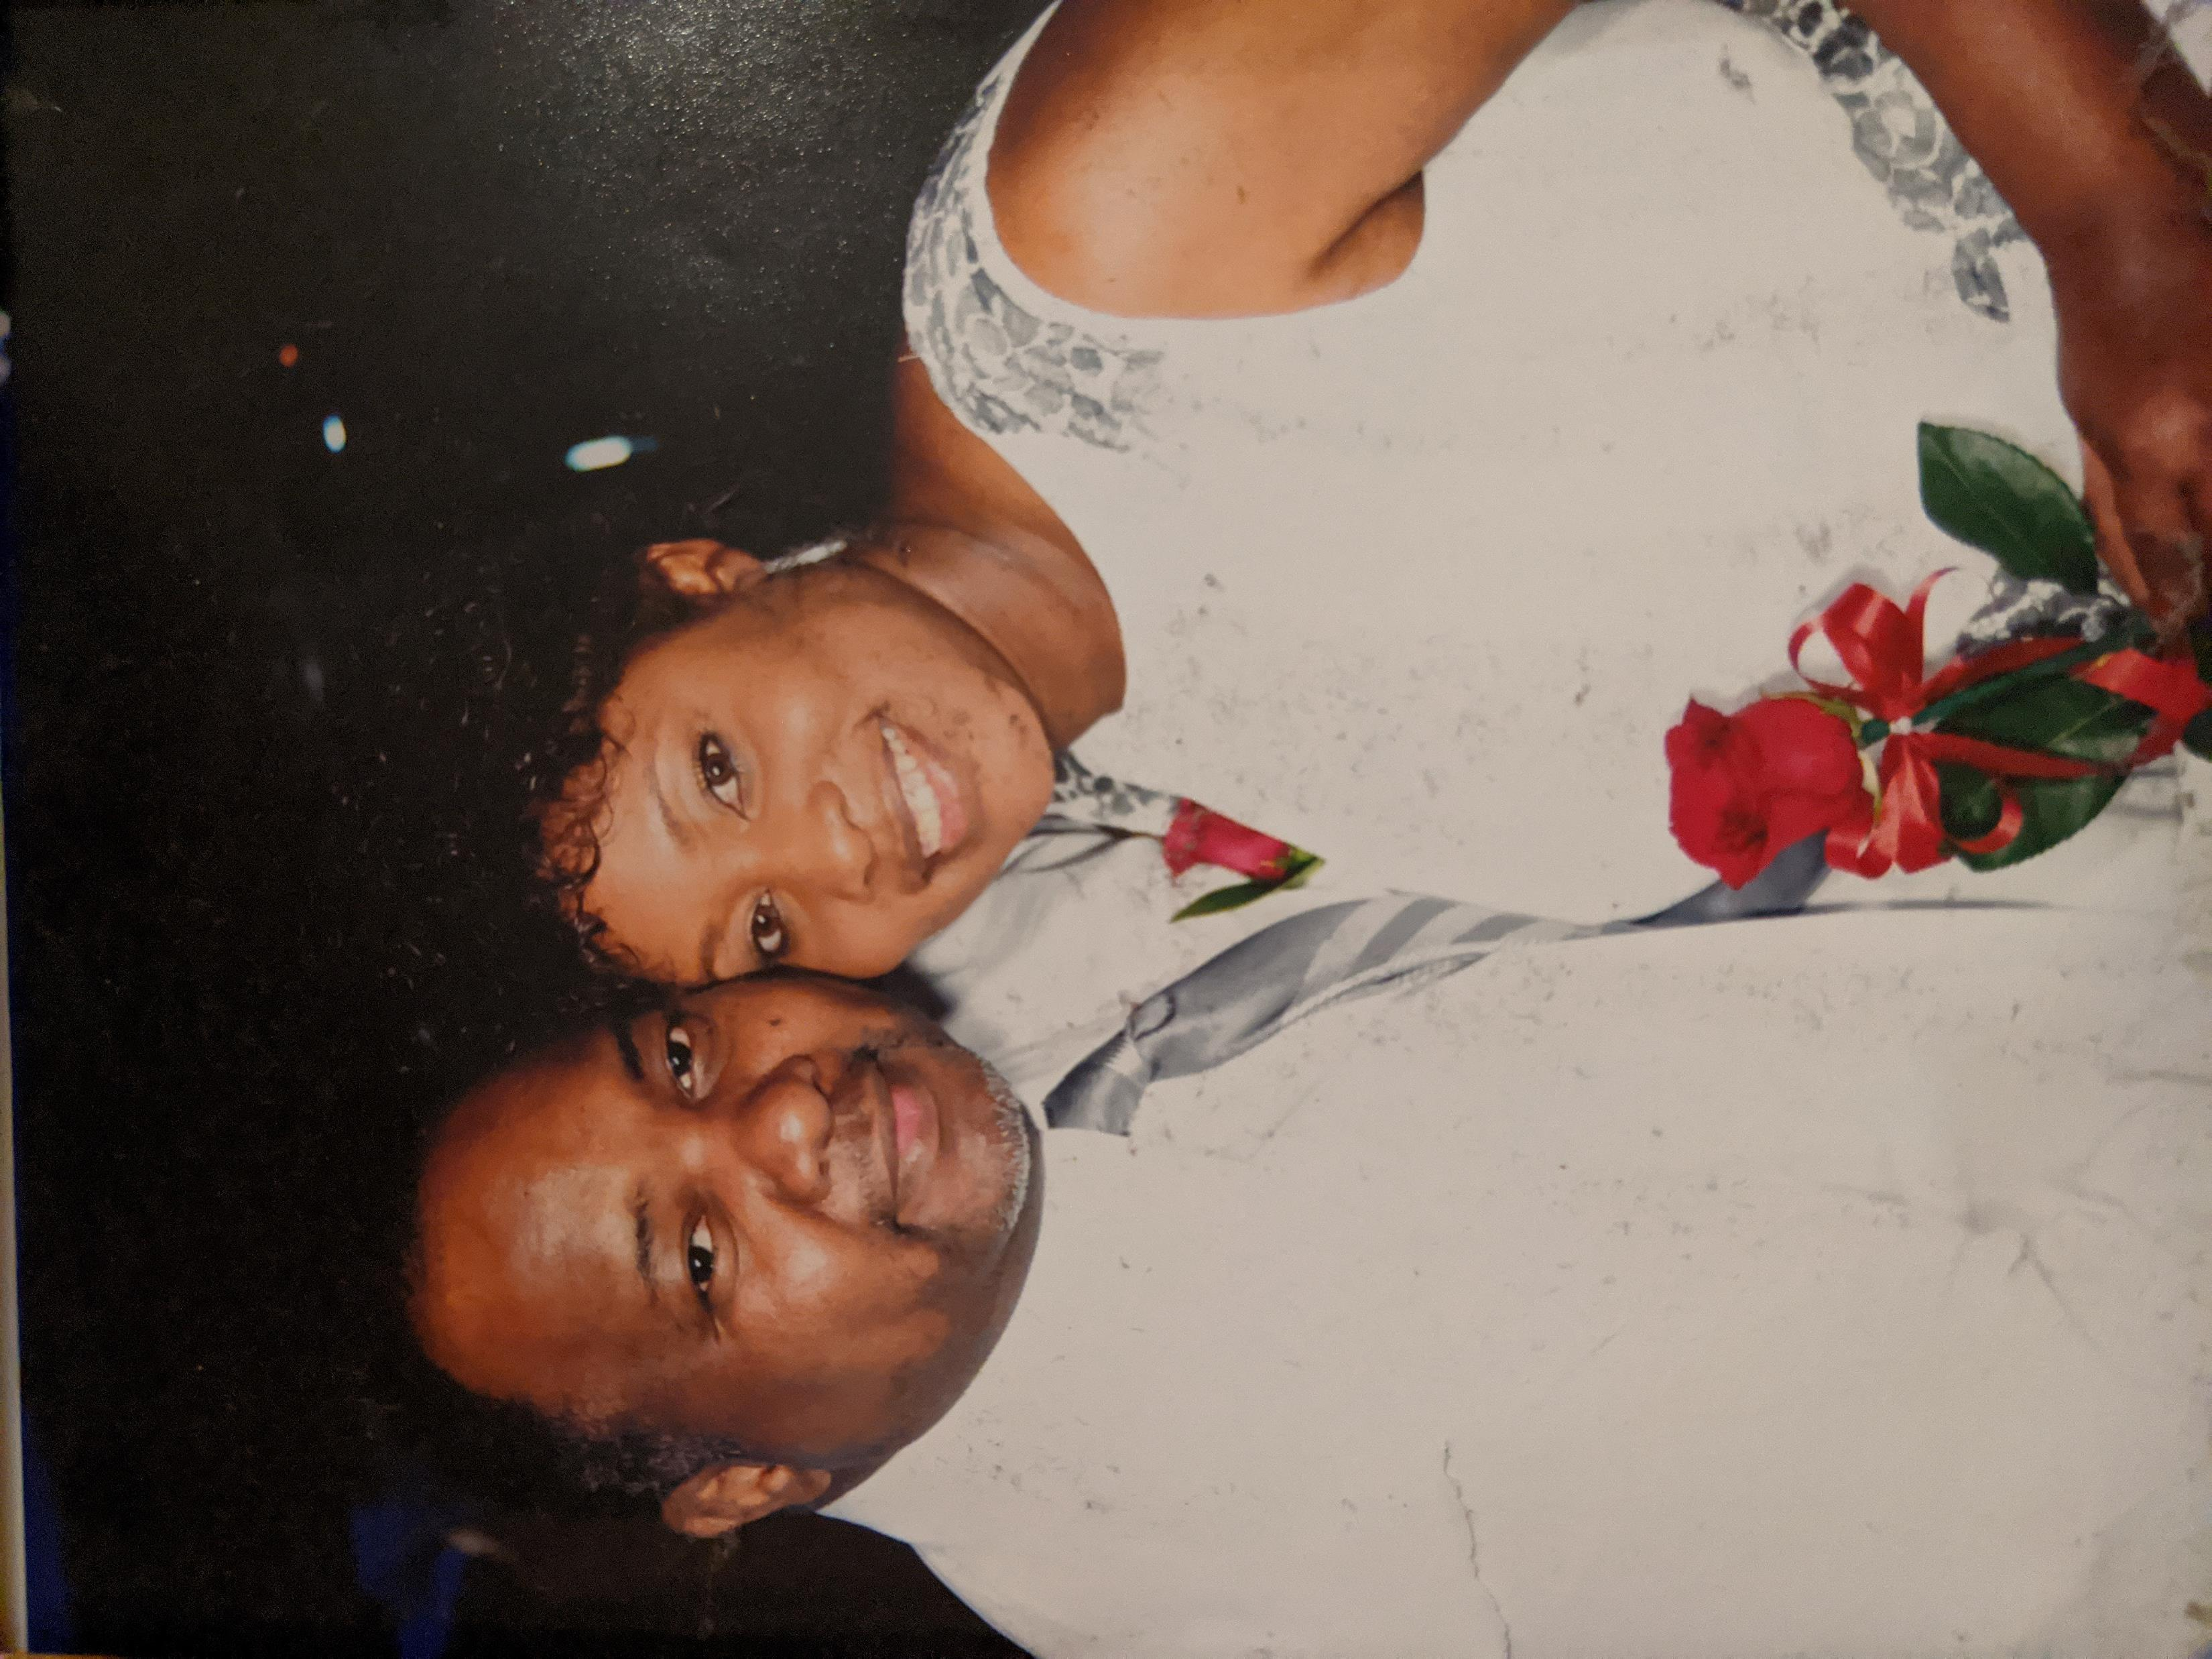
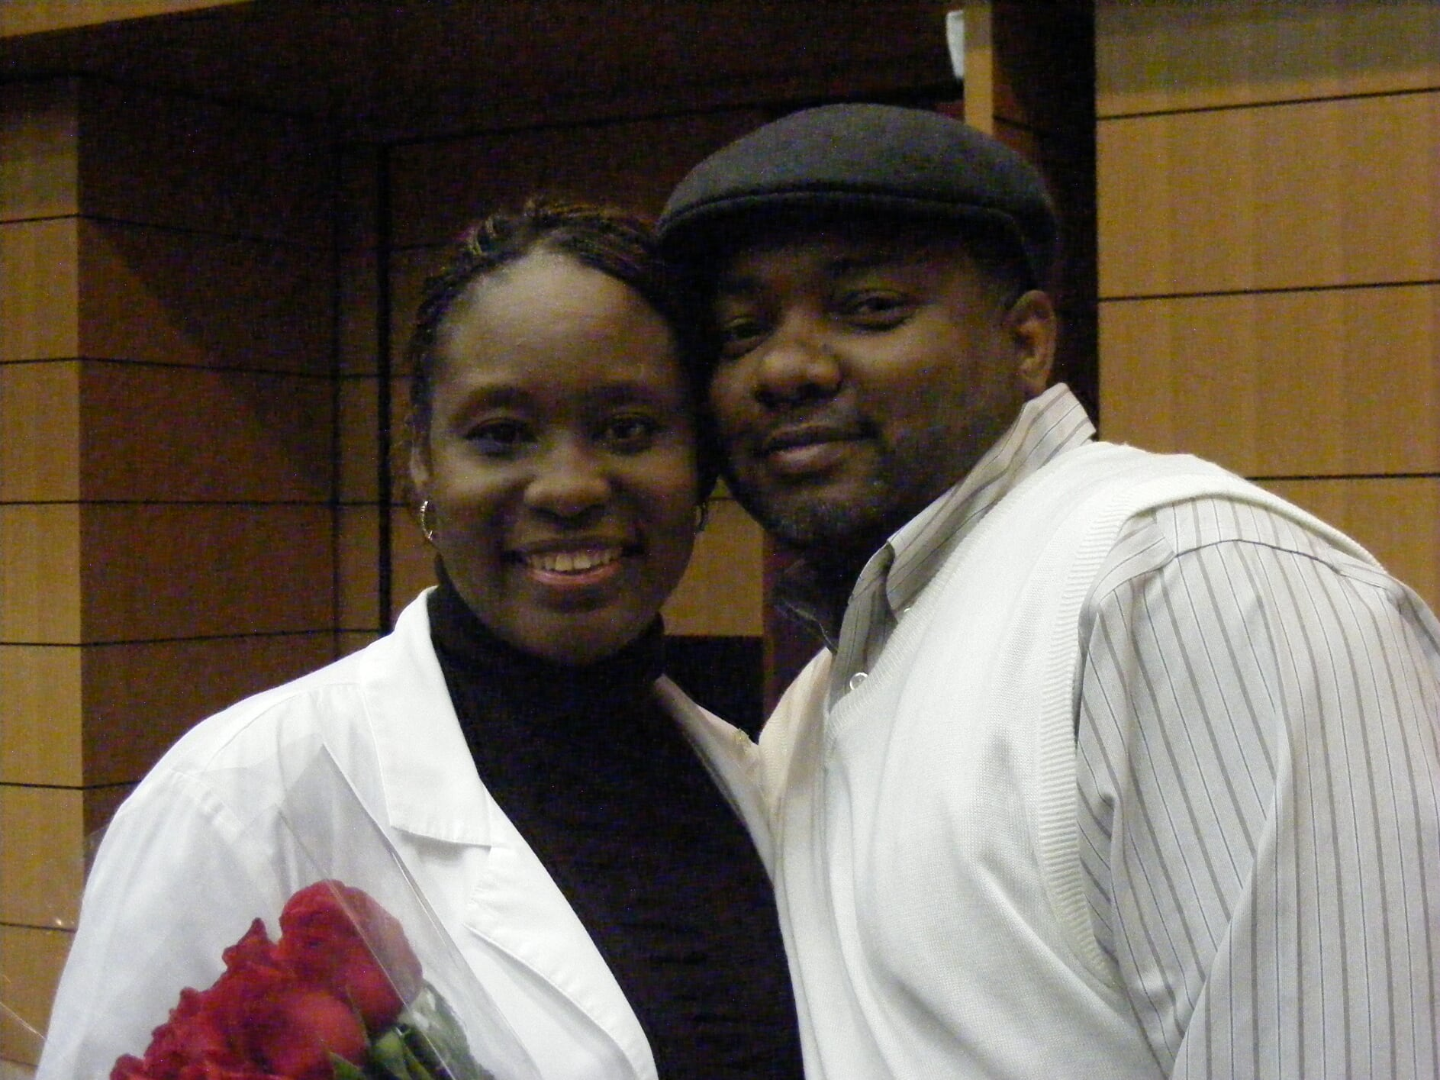

Slide 15
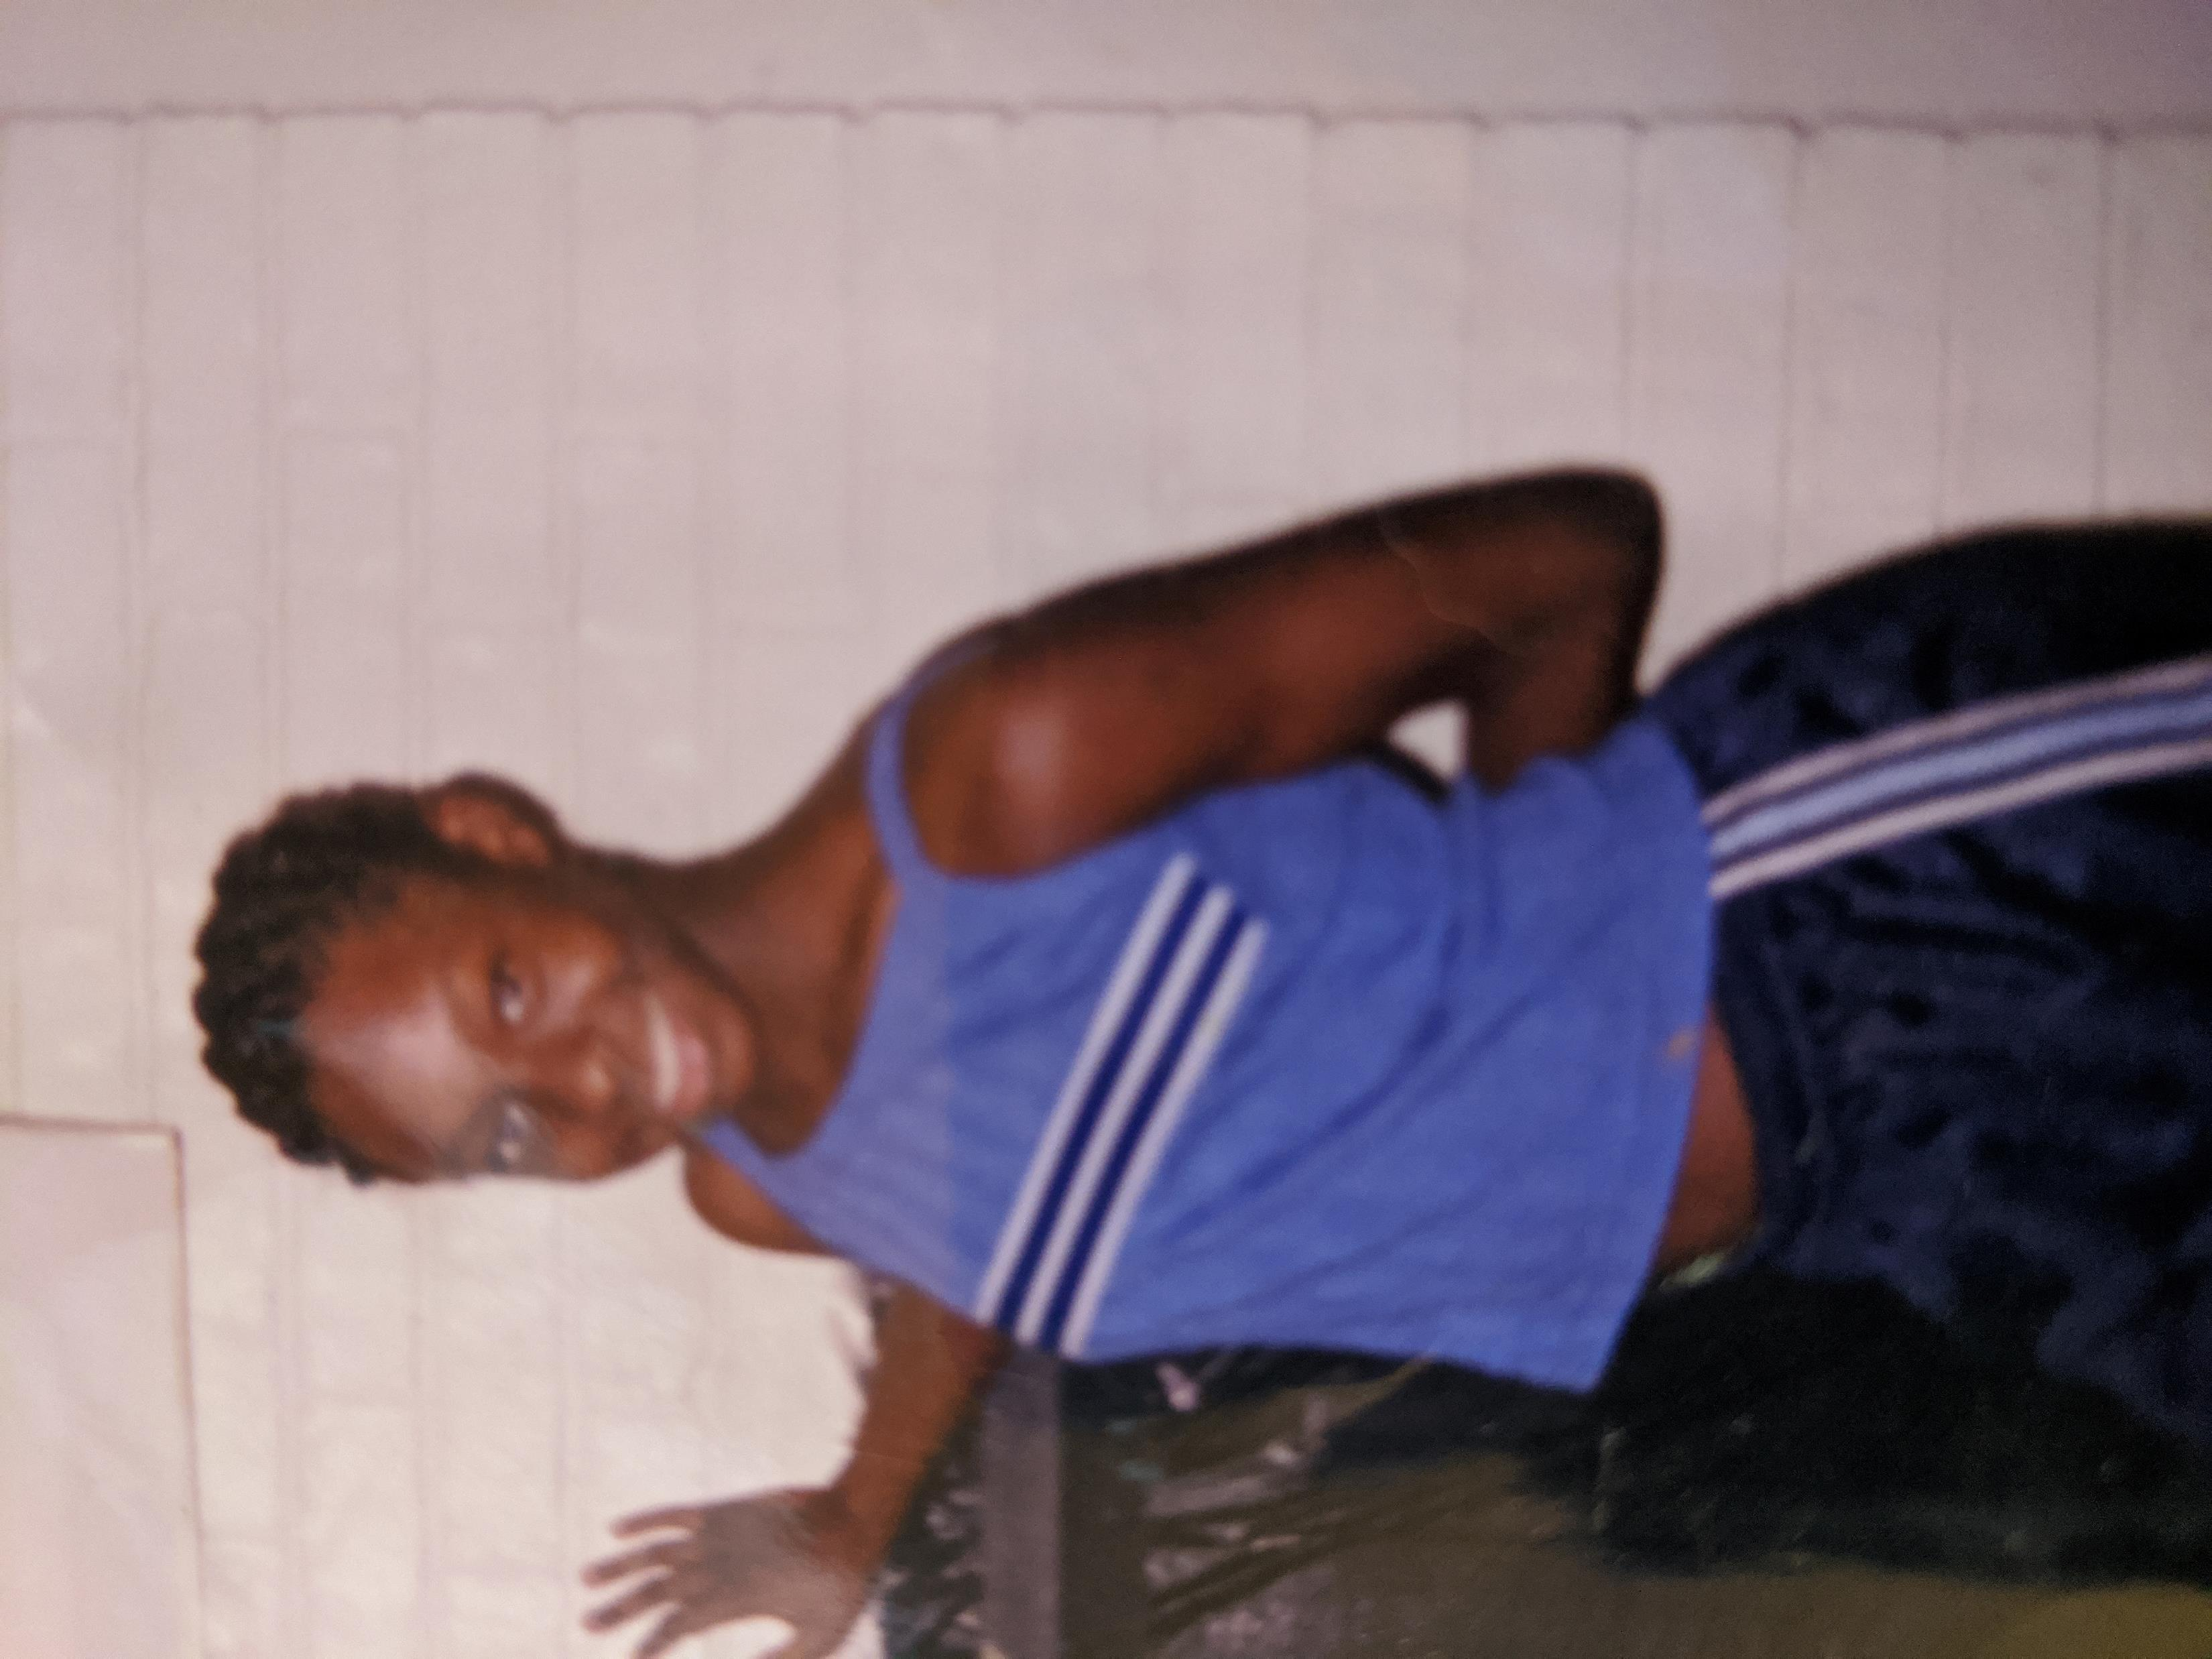
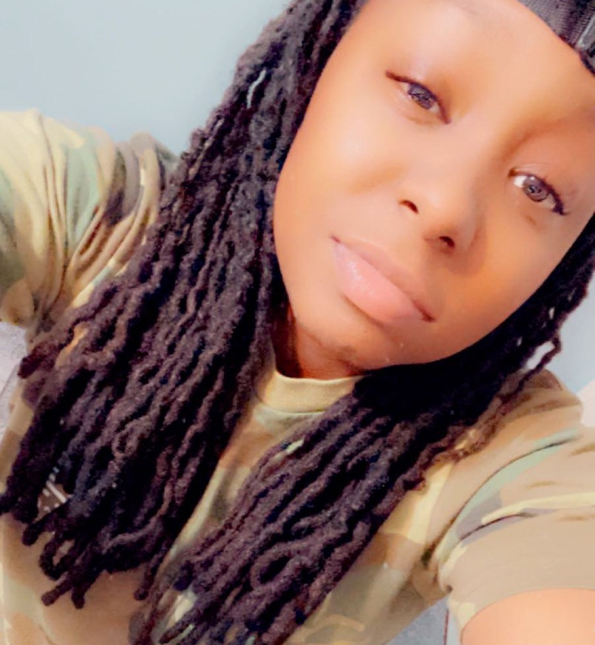
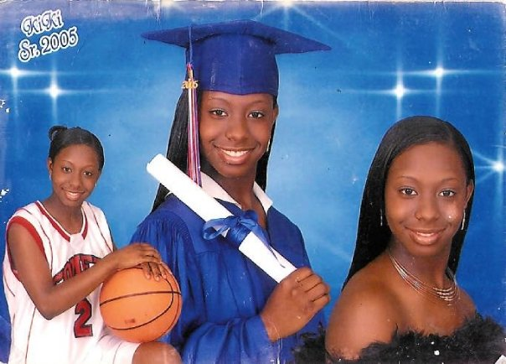
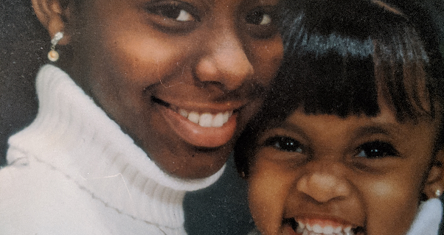
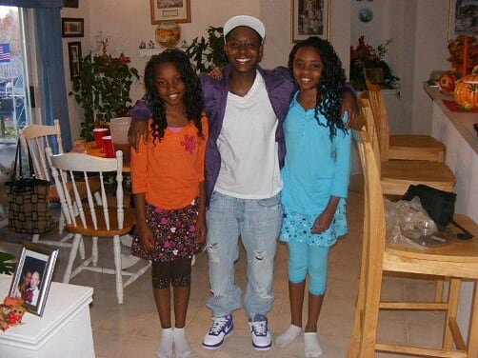
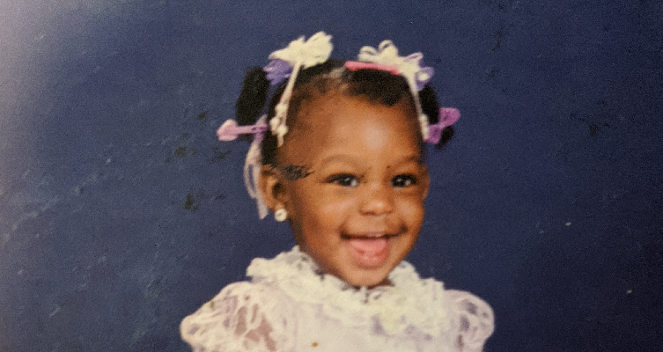
The Oldest Zakiya a.k.a Kiki

Slide 16
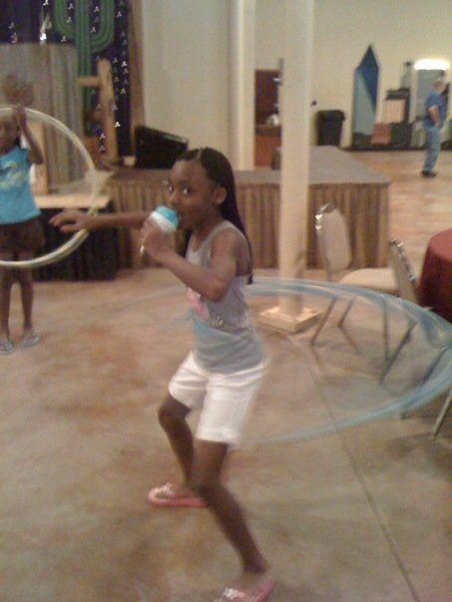
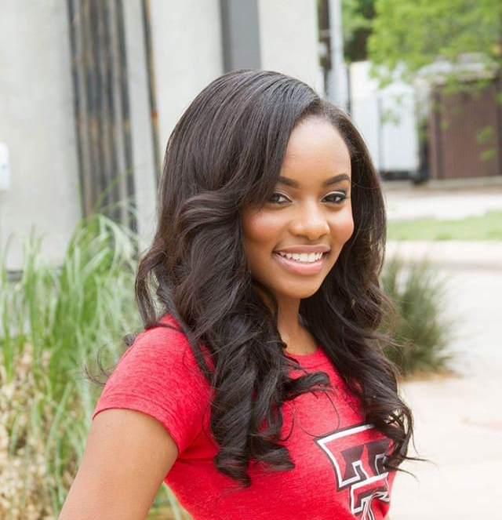
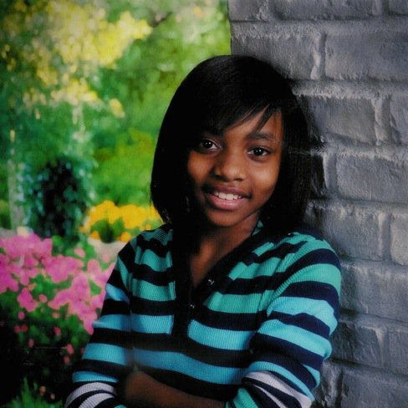
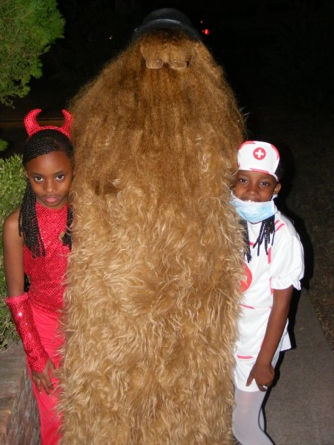
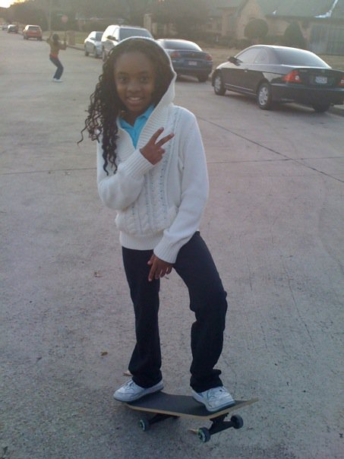
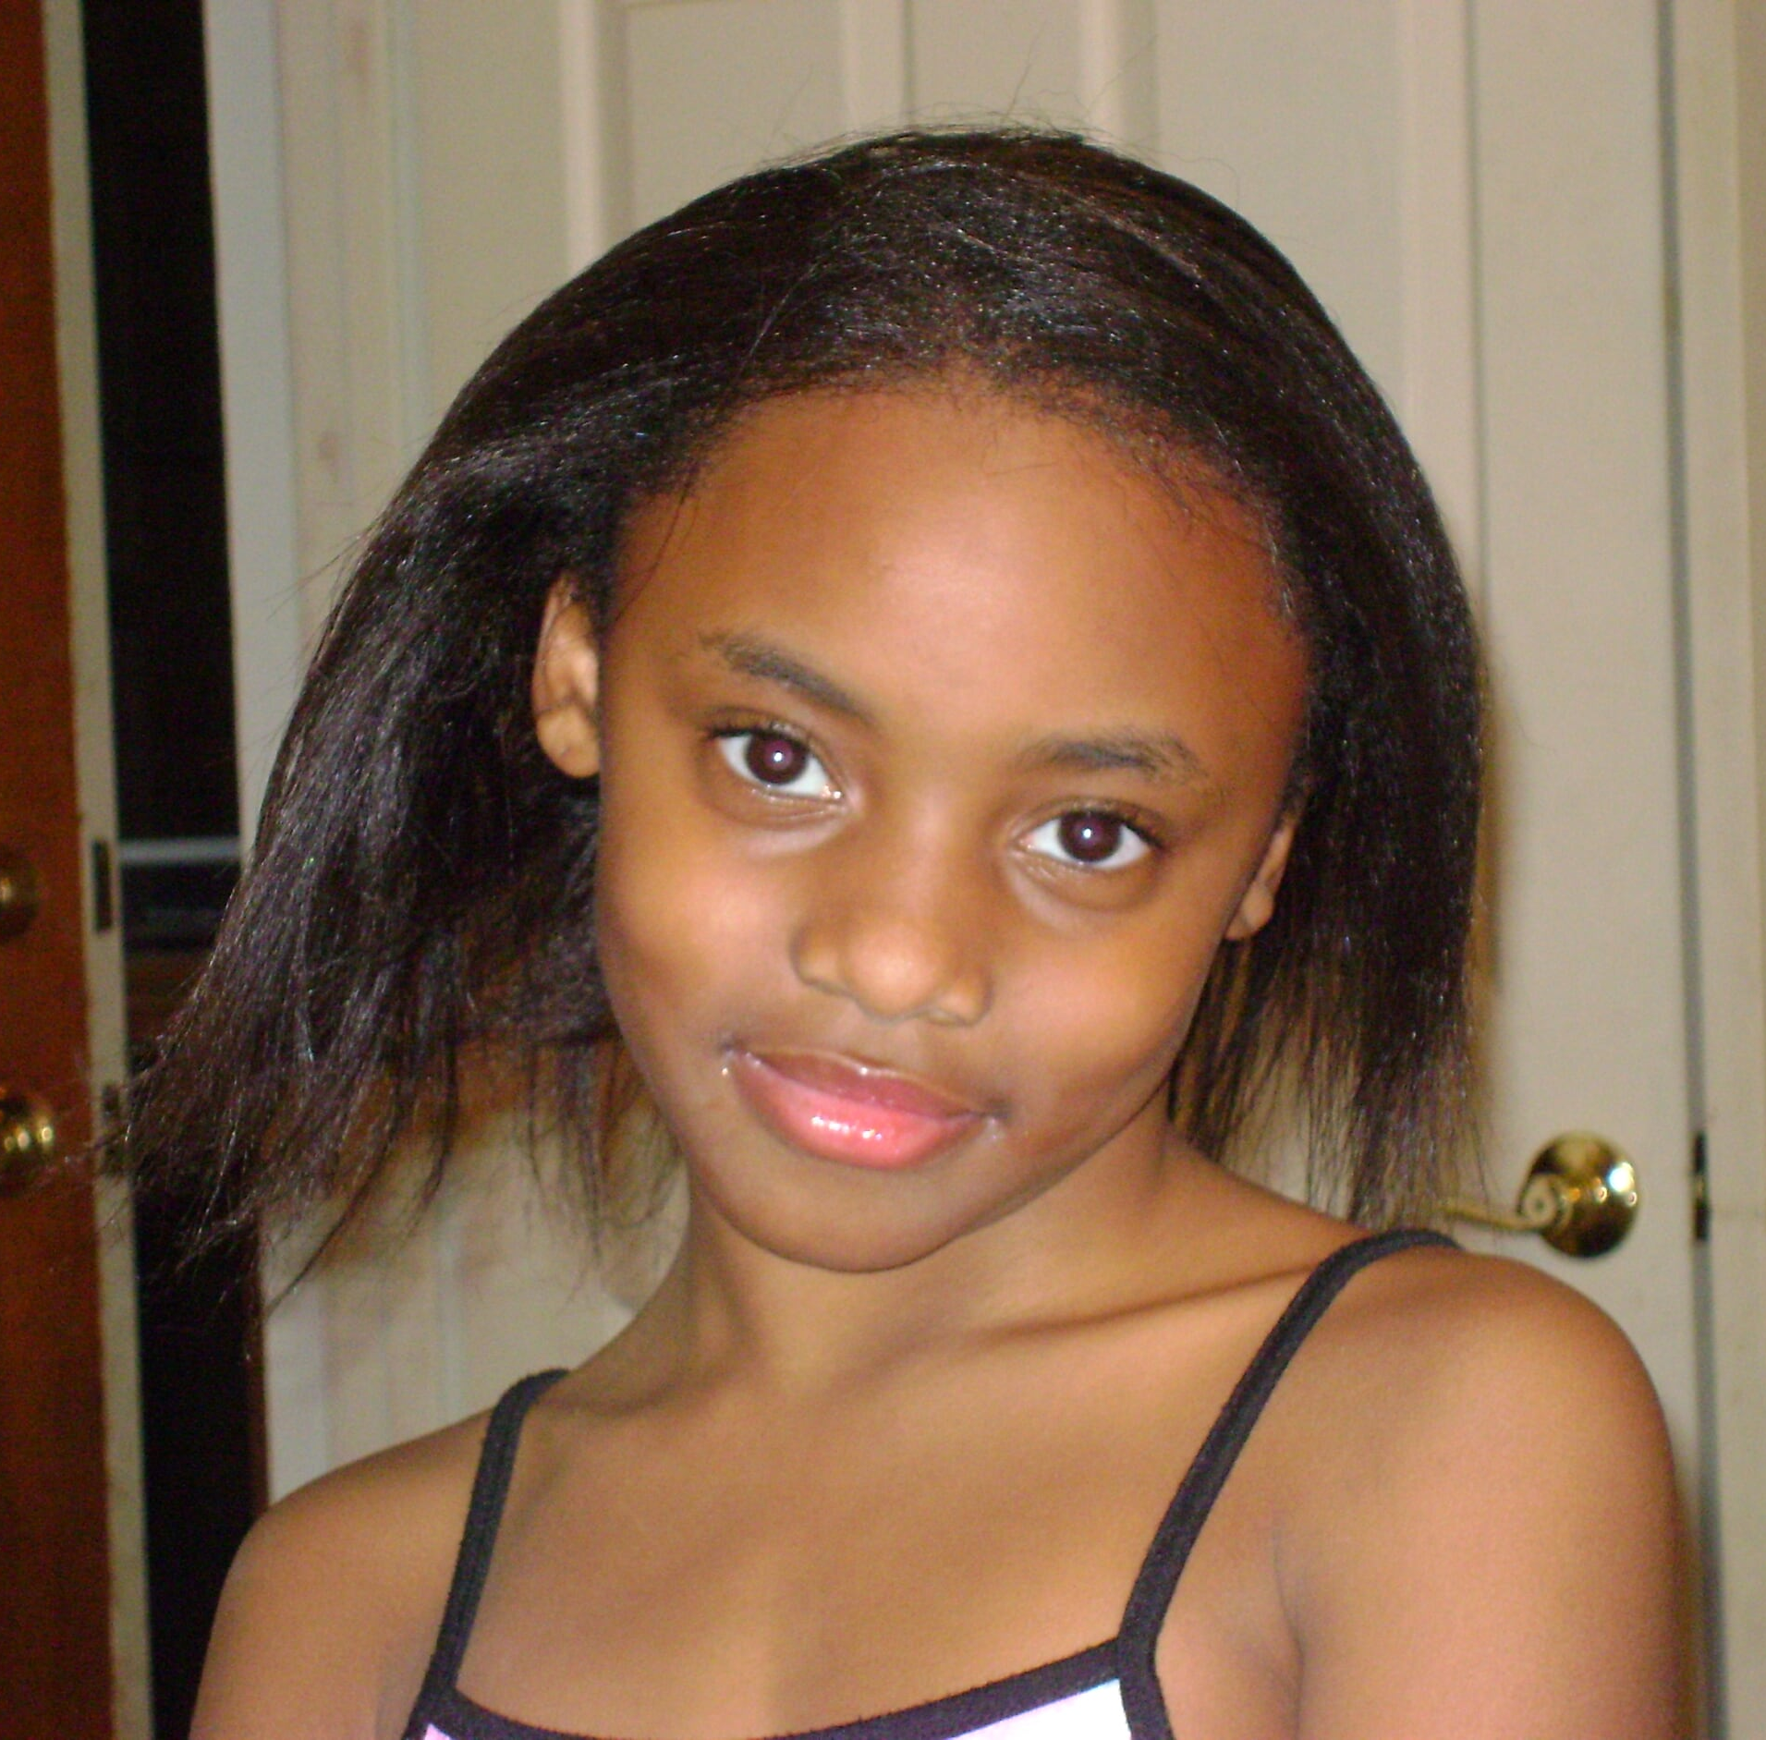
The Middle Danielle a.k.a Danie

Slide 17
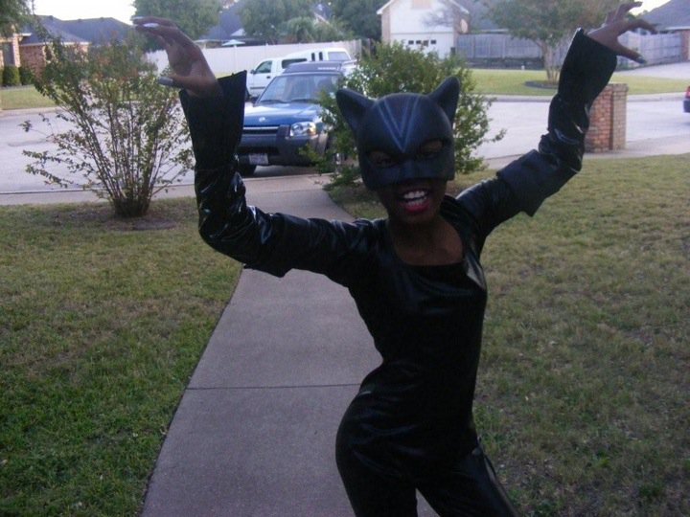
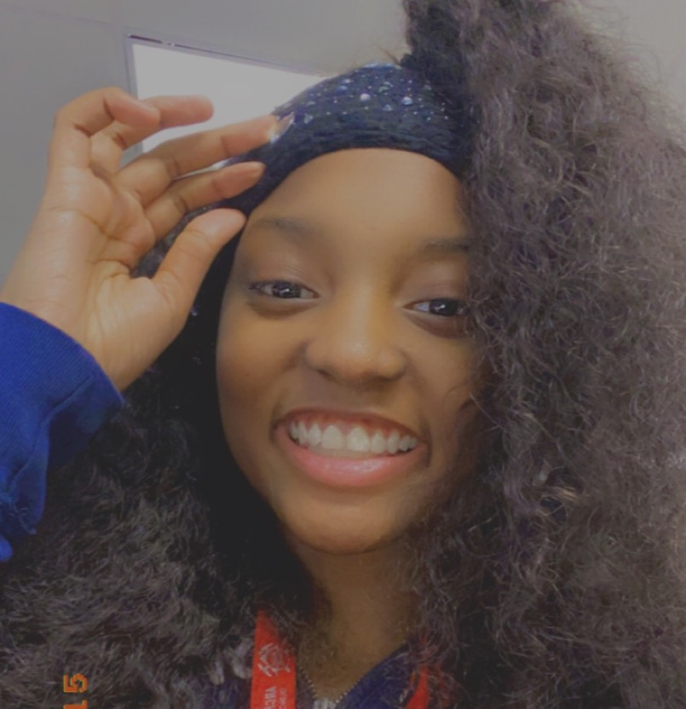
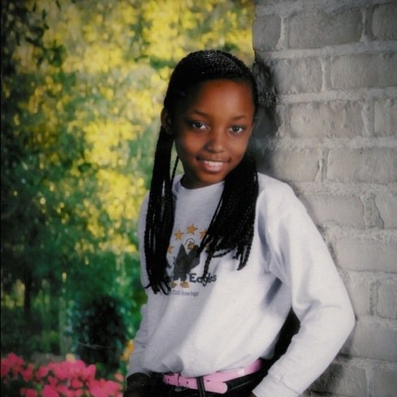
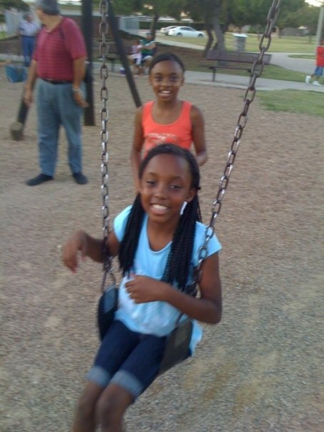
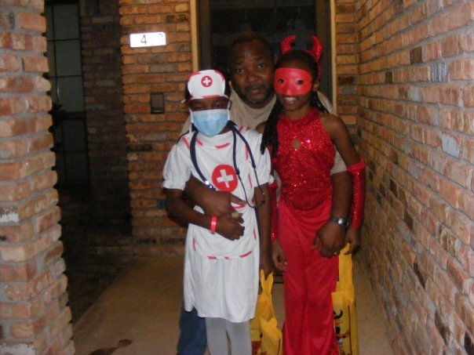

The Baby Daydria a.k.a Dada

